Slide 1

International Center for Appropriate and Sustainable Technology
On-Farm Canola Crushing and Biodiesel Facility,
Stratton, CO
Presented to:
Sierra club Rocky mountain chapter
Energy committee
Presentation by:
Sam Anderson
iCAST

Slide 2
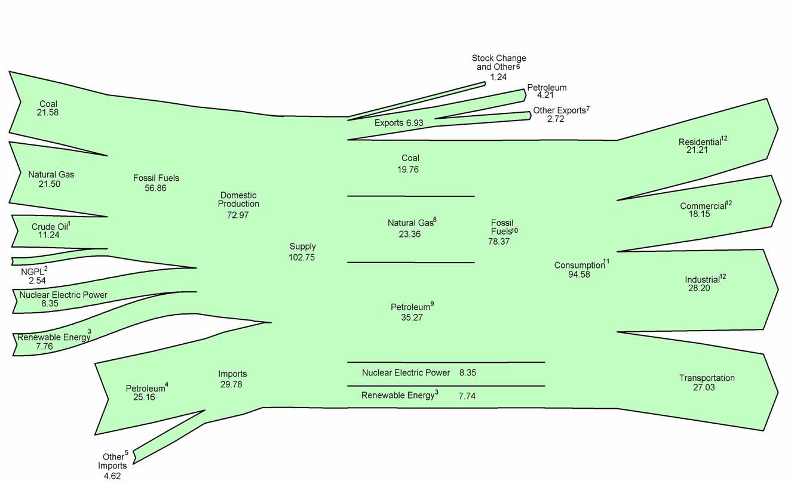
US Energy Flow, 2009
Notes:
The US consumes incredible amounts of energy (20% of world’s total consumption, 5% of world’s population)
We could also consider this in terms of three primary-use categories: electric power (45%), heat (26%), and transportation (29%).
In other words, transportation = liquid fuels = petroleum.
Without petroleum, we have no commerce. This is a very dangerous predicament. We need more options.
So much talk about “renewable energy” (= electric power, ~45% of primary energy use)
What about Renewable Fuels? (I don’t know where they are in this diagram…)

Slide 3
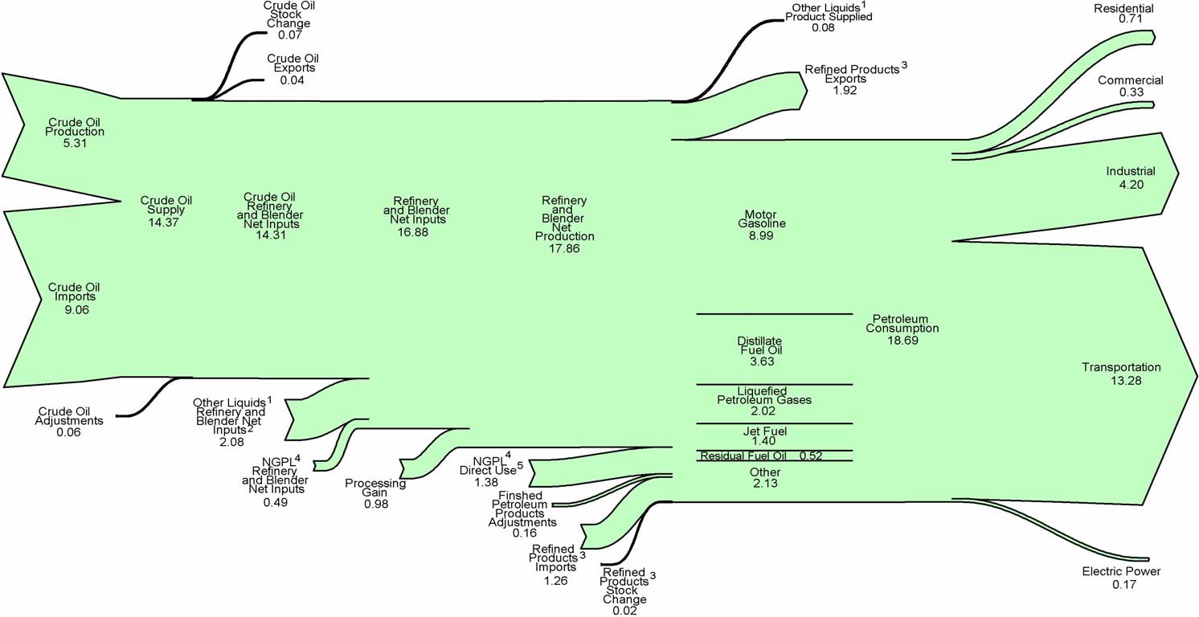
US Petroleum Flow, 2009
Notes:
US consumption: ~20 Million barrels per day (300 Billion gallons per year, 25% of world production) Diesel = ~60 Billion gallons per year
Industrial: 4.2 Million barrels per day (65 Billion gallons per year) includes Agriculture’s 3.5 Billion gal/yr.
How much biodiesel can we make?
Did global oil production capacity peak in July, 2008?

Slide 4
Biodiesel Q&A
What is it?
How much could we make?
How “green” is it?
Why bother?
Notes:
What is it? A high-energy, premium liquid fuel derived from vegetable oil. B5, B20, B100 (common blends)
How much? Available resources in US = approx. 1 Billion gal/yr (mix of soy oil and low-value, non-commodity, oils and fats; ~15% of annual US production of oils and fats)
Algae could change that to 10 Bill.? 20 Bill.? 50 Bill.???
(corn ethanol production ~10 Billion gpy; cellulosic ethanol potential estimated at 90 Billion gpy)
Pros:
Carbon neutral (in closed loop production)
“no” sulfur
Premium fuel
EROEI = 3.4 (Biodiesel returns 3.4 times more energy than total energy inputs – even if inputs are fossil fuels)
Cons:
No NOx benefit
Oil has very high nutritional value (use waste oil instead?)
Global tropical deforestation
Why? Utility: premium fuel – high fuel specs; sustainable (if done right), renewable, energy security, fossil carbon reduction, fuel diversity

Slide 5
Notes:
Notes on biodiesel history:
1880s onward: Proctor & Gamble produces massive quantities as a detergent (co-product of soap production)
1900: Peanut oil demonstrated in Diesel engine at Paris World’s Fair. (not by Rudolph Diesel, though he recognizes its importance)
1942: Germans test biodiesel for first time in diesel engines.
1989: “biodiesel” is coined.
1992: European countries begin adopting biodiesel fuel standards and incentives
2001: U.S. begins adopting biodiesel fuel standards and incentives
2008: U.S. production capacity reaches 3 Billion gpy; U.S. production peaks; U.S. biodiesel industry collapses.
Factors contributing to collapse in 2007/2008 (besides the recession):
U.S. production capacity overbuilt by 3:1 compared to available resource.
U.S. headlines and media blitz coin the term “biofools” and claim biodiesel is a “crime against humanity”: European (and U.S.) demand drives tropical deforestation on an unprecedented scale to make way for palm oil plantations.
$1.00/gallon Federal producer tax credit ends in December, 2008

Slide 6
On-Farm Canola Crushing and Biodiesel Facility
Stratton, CO
Chuck clapper, owner
Design, construction
And commissioning by Sam Anderson, chuck clapper and
icast
Notes:
Chuck Clapper: bought his first 10 acres when he was 15 y.o. Owns ~22,000 acres today (35 square miles) (new co-owner of another 30,000 acre ranch.)
Mostly corn and wheat + 1,000 head of cattle. (more cattle to come…)
Tractors use 50,000 gallons of diesel per year. Irrigation pumps and generators use another 50,000 gallons of diesel.

Slide 7
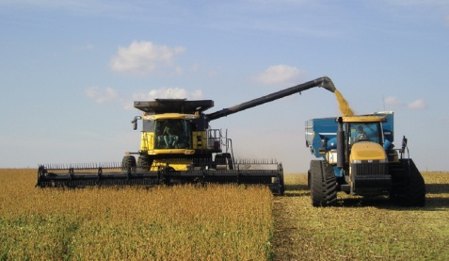
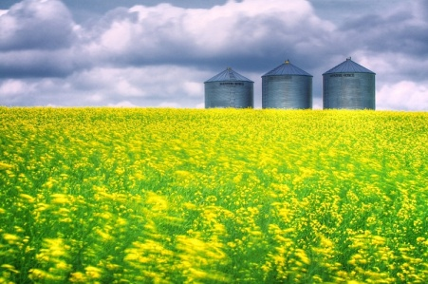
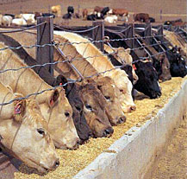
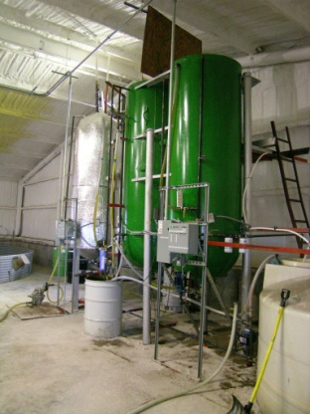
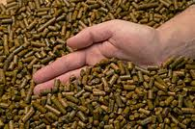
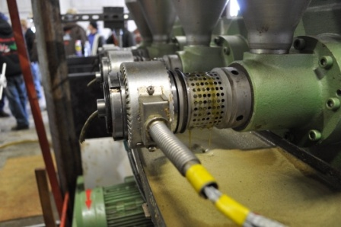
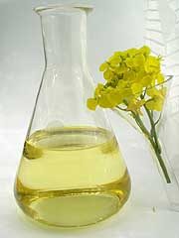
Canola: Field to Feed and Fuel
Notes:
(Show samples of canola seed, meal pellets, unfiltered oil, biodiesel + glycerin, finished fuel.)
Two products; two closed loops.
Motivation for this project:
2007: feed prices were 7 cts per pound ($140/ton)
2008+: feed prices were 20 cts per pound ($400/ton)
Also: hedge against volatility of diesel prices (Direct and indirect cost of energy is ~25% of total production costs in farming)

Slide 8
Production Capacity
Raw material:
450 tons (18,000 bu) canola per year
~800 acres dryland crop
< 400 acres irrigated
Product:
300 tons of meal
35,000 gallons biodiesel per year
Notes:
2 lbs of meal per cow per day.
100 gallons of biodiesel per acre (irrigated cropland)
1 section of land = 1 square mile = 640 acres
Plans to expand capacity to 60,000 gallons per year (= 1 section irrigated cropland)

Slide 9
Production Capacity
Process Equipment:
Seed cleaner
120 bu/hr
Expeller (seed) press
100 gal/day
Filter (oil) press
25 gal/hour
Biodiesel reactor
750 gal/week
Notes:
Expanded capacity = 2nd seed press.

Slide 10
Production Costs and Value
Notes:
450 tons per year = 18,000 bushels
50 pounds per bushel
1 bushel = 34 pounds of meal + 2 gallons of biodiesel
Costs and values are somewhat arbitrary since they are internalized.
Note seed production cost is more than half of total production costs.
Value of meal and biodiesel is split 50/50, even though bulk of product is meal.

Slide 11
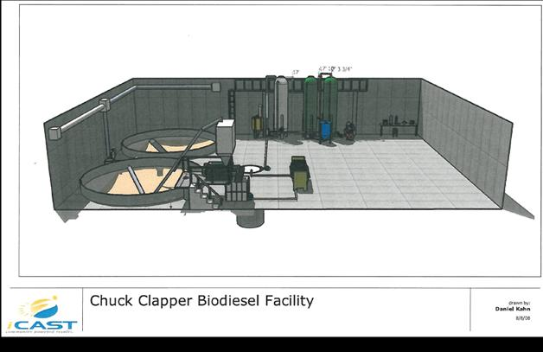
Facility Layout
Notes:
Entire project cost ~ $240,000.
Harvested seed is dumped from trucks into a loading port on the other side of the back wall and drops into a causeway to a 30-ft deep pit beneath the large storage bins.

Slide 12
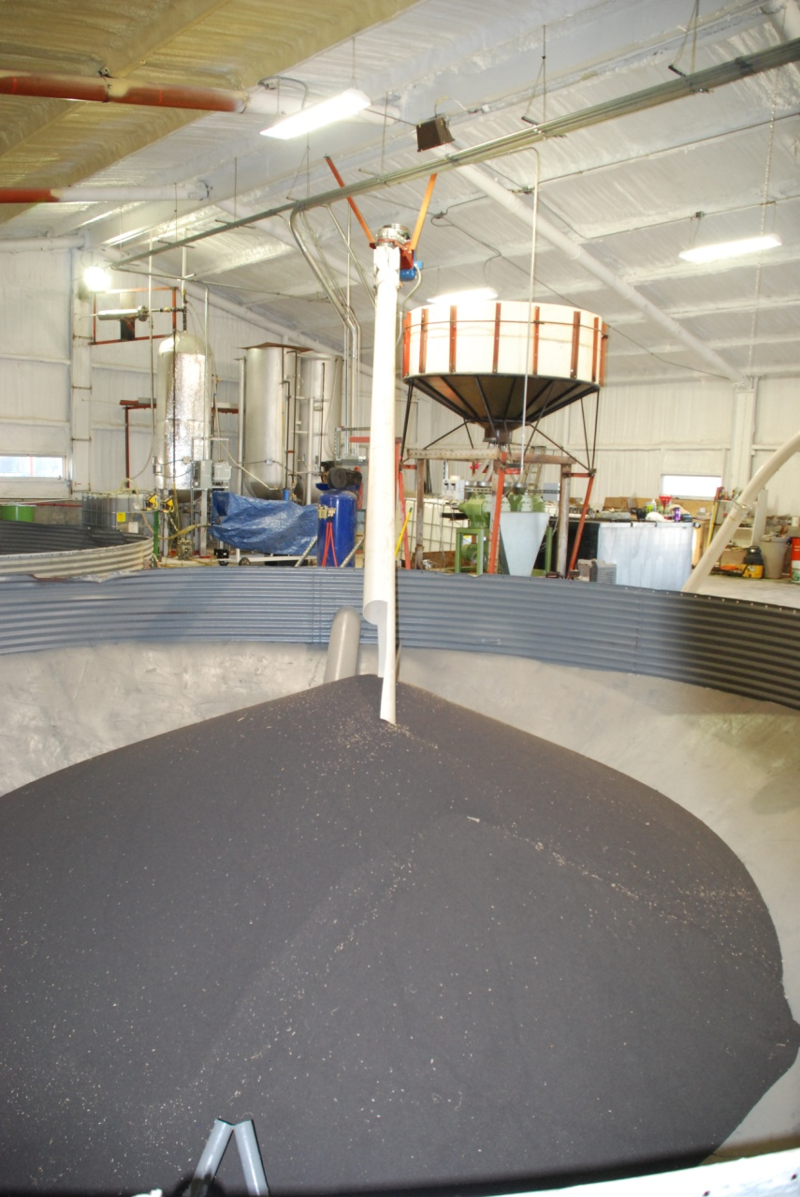
Canola Seed
Notes:
Note the “dockage” in the seed: leaves, husks, twigs, sand, etc.

Slide 13
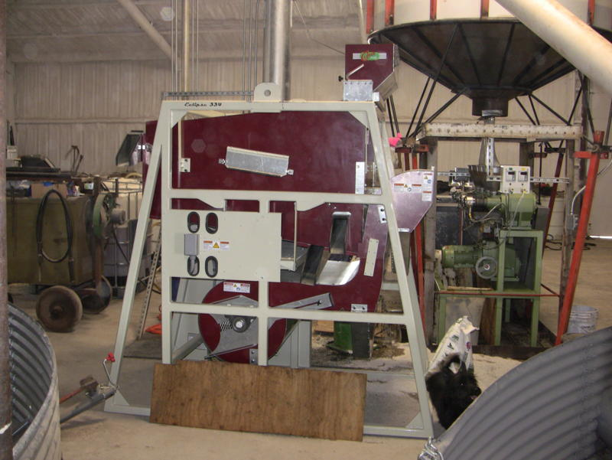
Seed Cleaner
Notes:
Removes dockage from seed (very important for crushing efficiency).

Slide 14
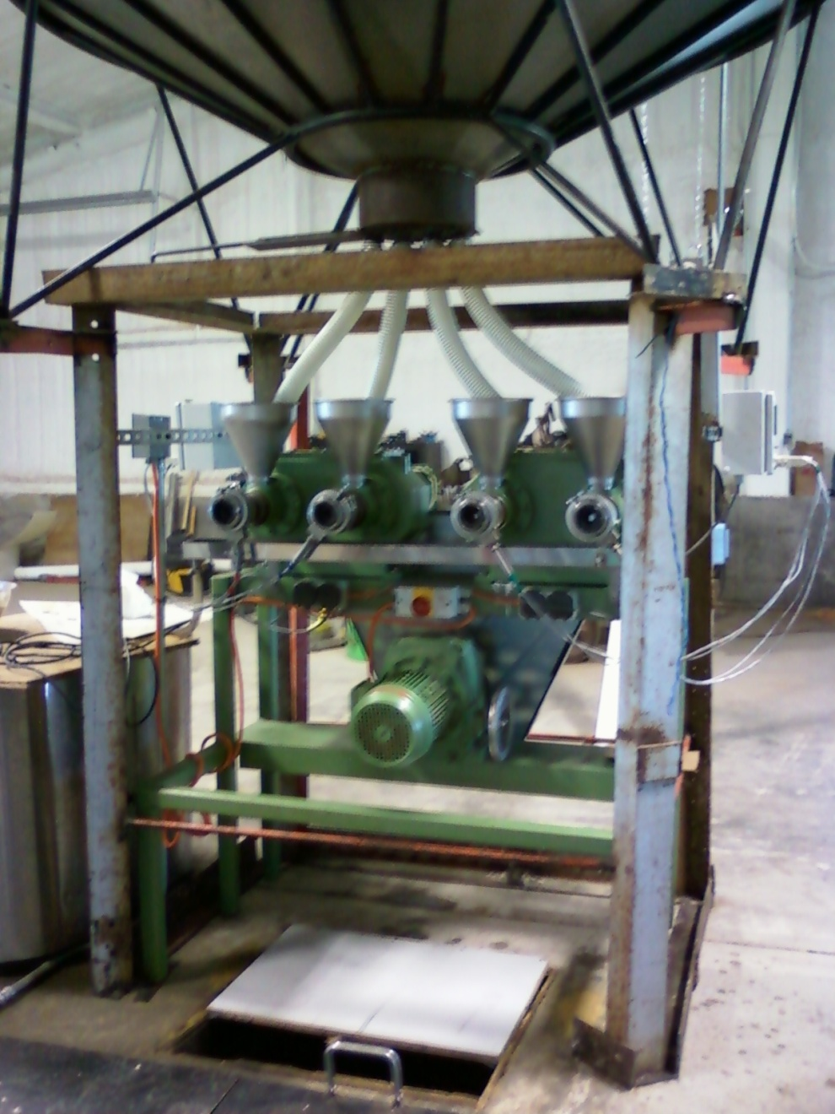
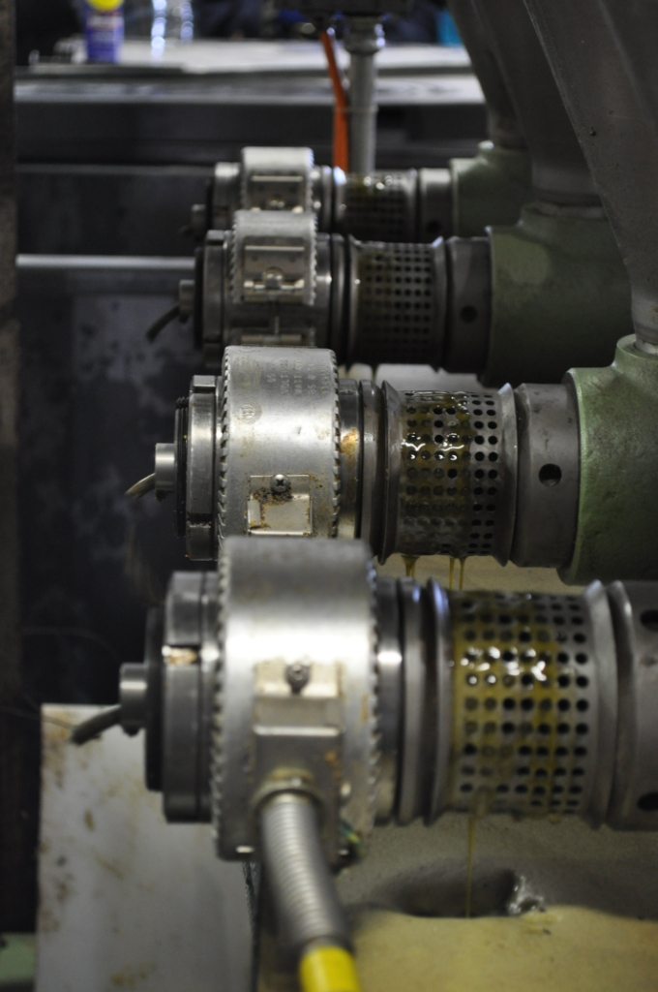
Expeller Press
Notes:
Note the oil dripping from the cylinder bore holes and press cake emerging from the nozzles on the end of the cylinders. The meal pellets (press cake) drop into a 20-ft deep pit under the press. A screw conveyor moves the meal pellets to feed bins outside, behind the press.

Slide 15
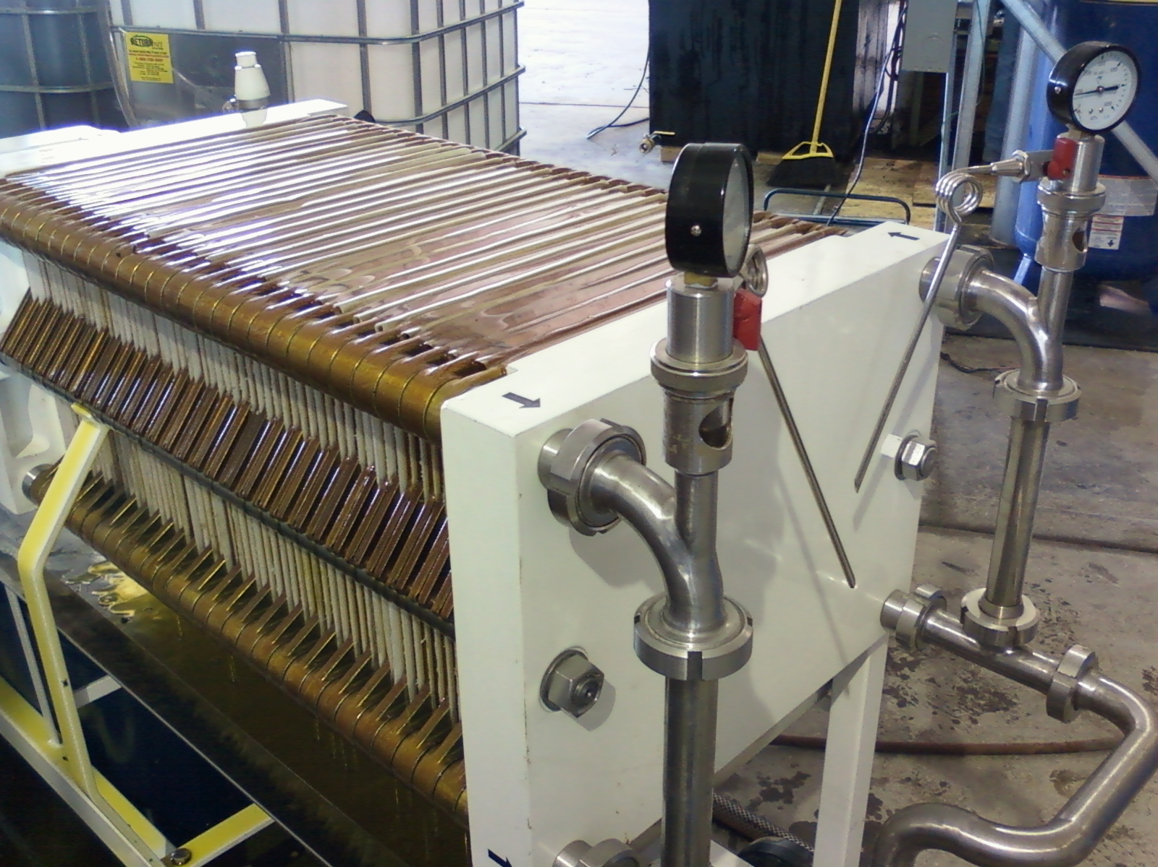
Filter Press
Notes:
Typically about 4 tons of pressure between the end plates. Oil gets squeezed through 72 sheets of filter cloth on its way to the oil storage tank. Before it goes to the oil press, the oil sits in an 850 gallon settling tank for several days (to reduce the sediment load and maintenance on the filters).

Slide 16
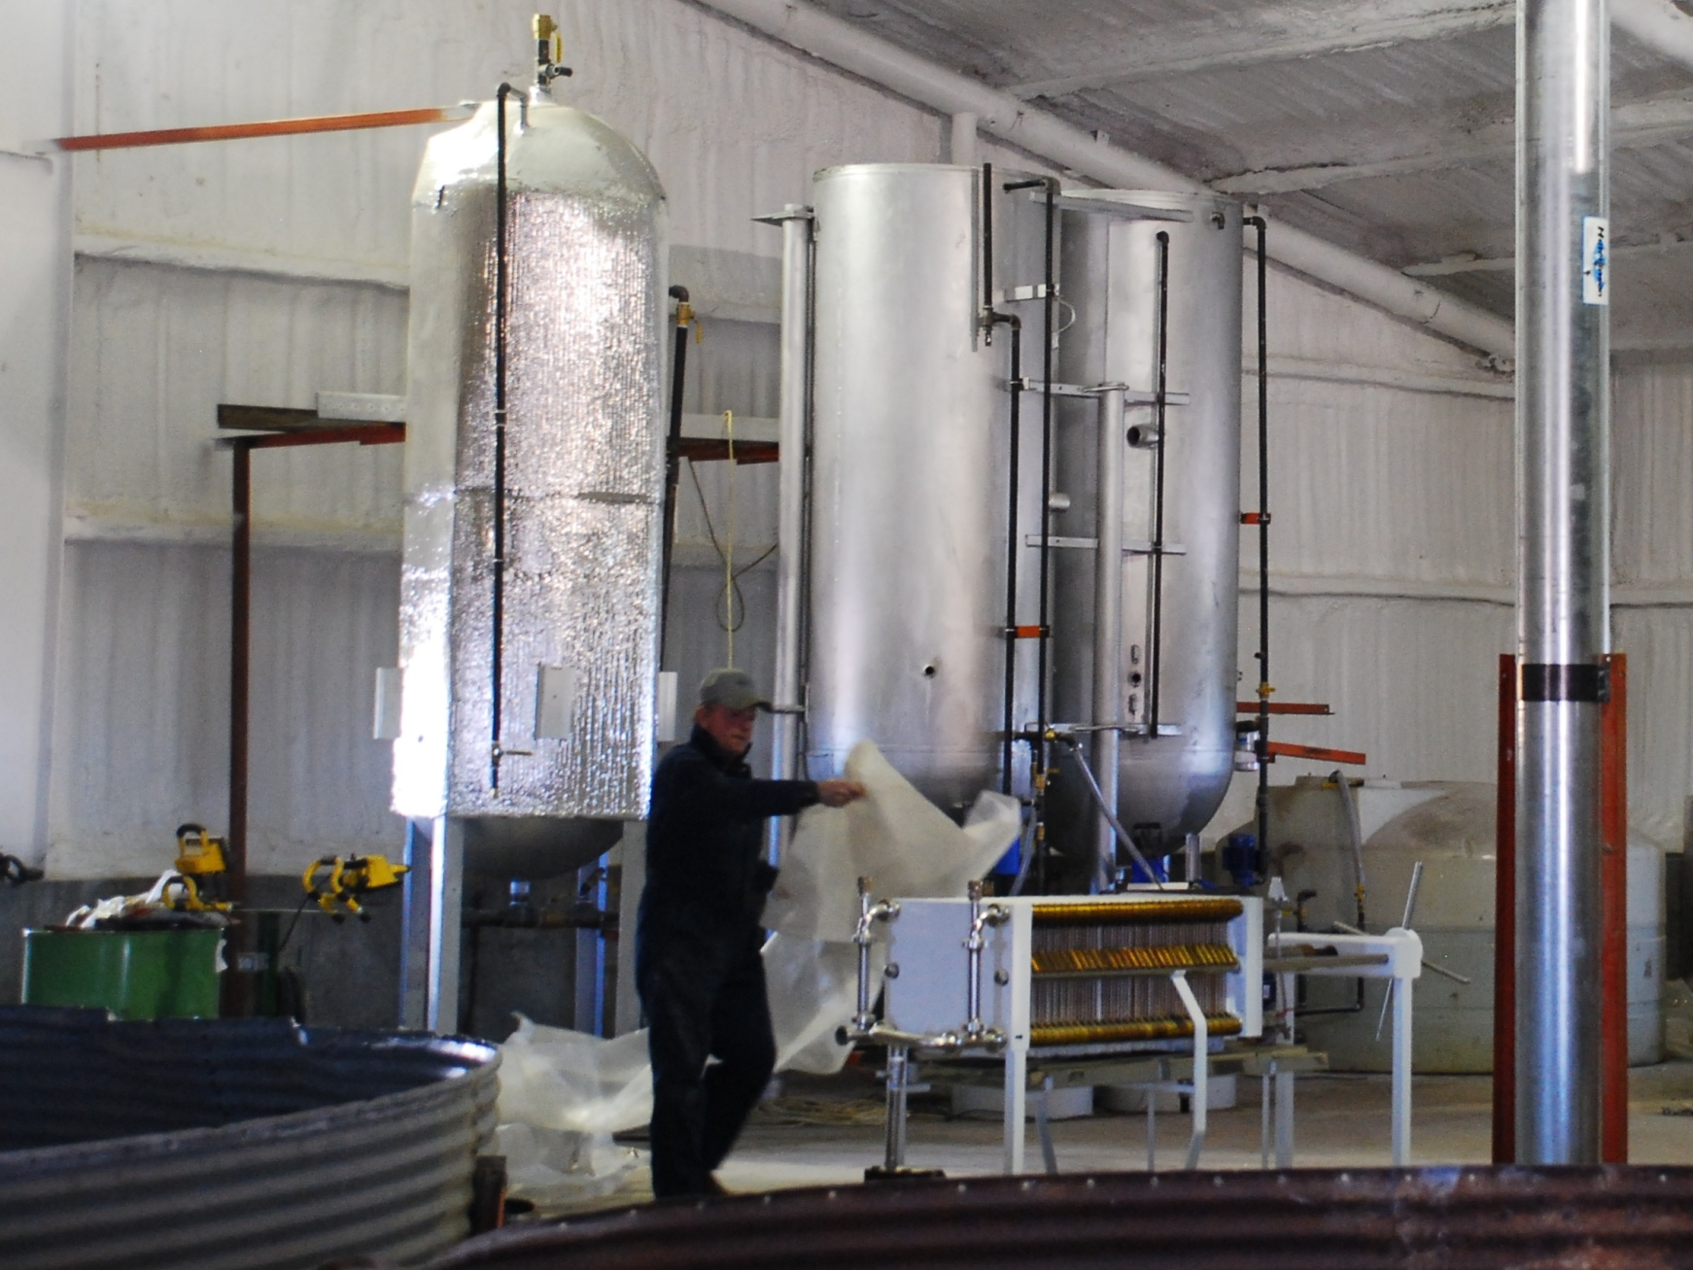
Biodiesel Processor
Notes:
500 gallon reactor tank (wrapped in insulation on left side), 750 gallon wash tank and 750 gallon dry tank (adapted from old propane tanks).

Slide 17
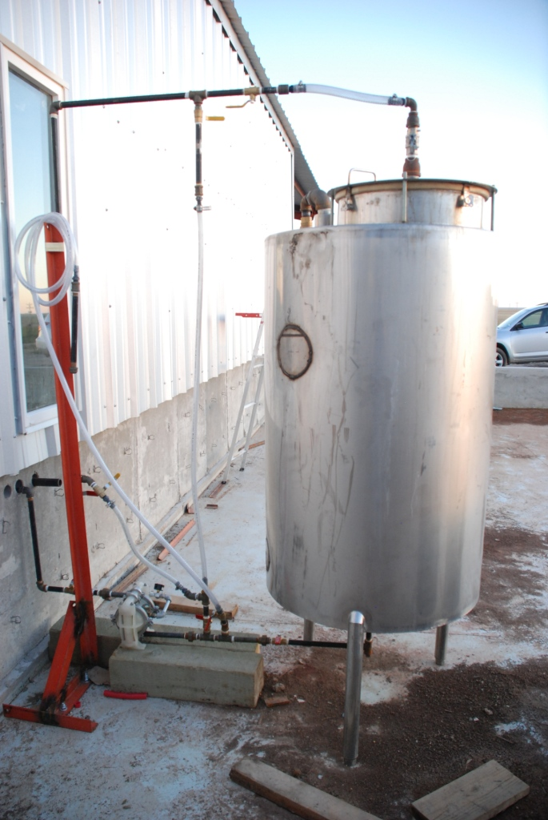
Methoxide Reactor
Notes:
(Outside for safety) Reacts methanol with potassium hydroxide to make catalyst for biodiesel reaction.

Slide 18
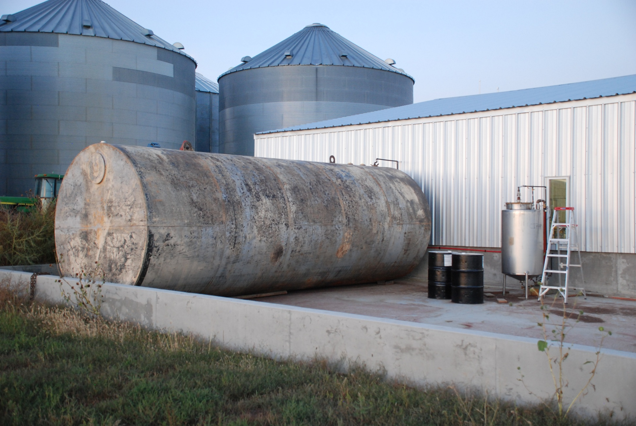
Fuel Storage
Notes:
25,000 gallon fuel storage tank. Note 55 gallon drums of methanol (black drums). 1 drum = one 250-gallon batch of biodiesel.

Slide 19
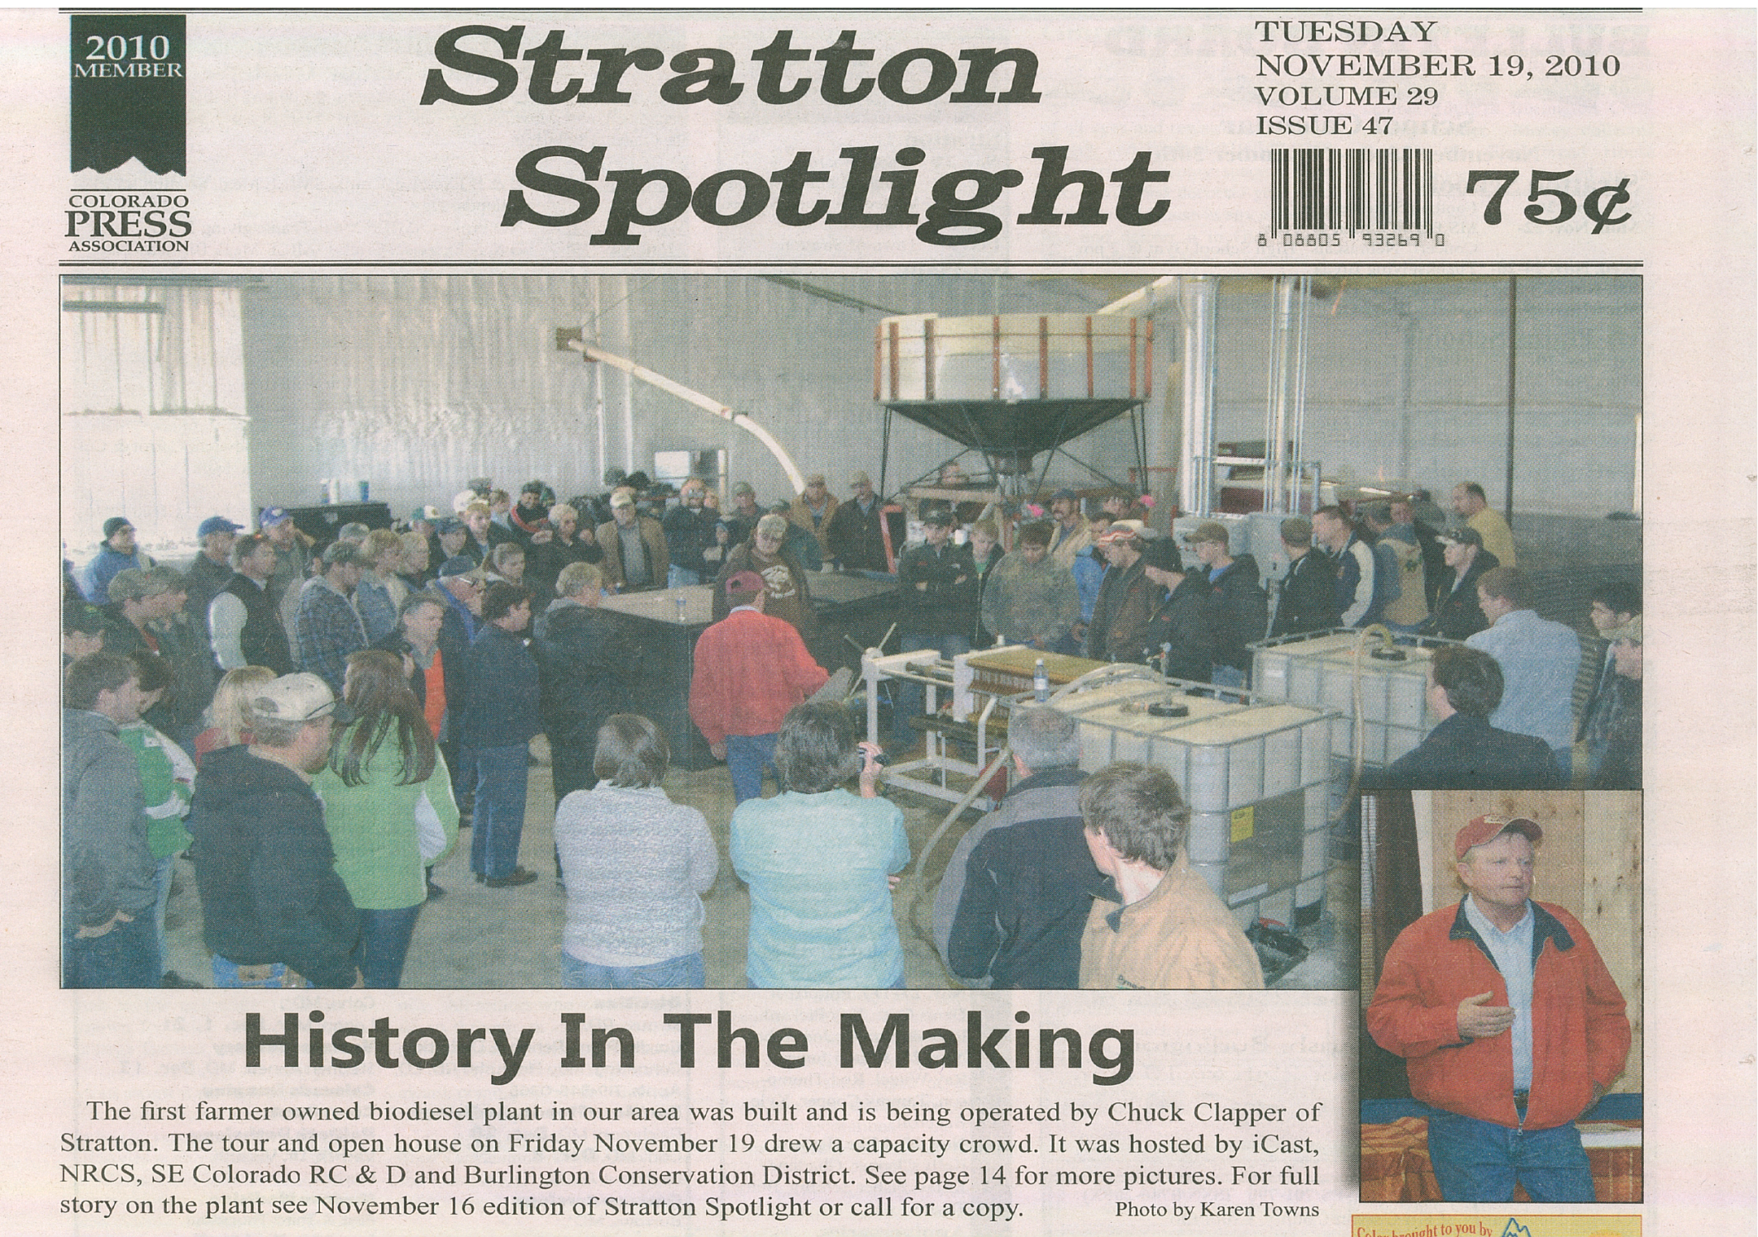
Notes:
Open house on Nov 19th, 2010. 130 attendees, 90-minute talk and demonstration by experts from CSU, Ravi and Sam, followed by a tour of the plant.

Slide 20
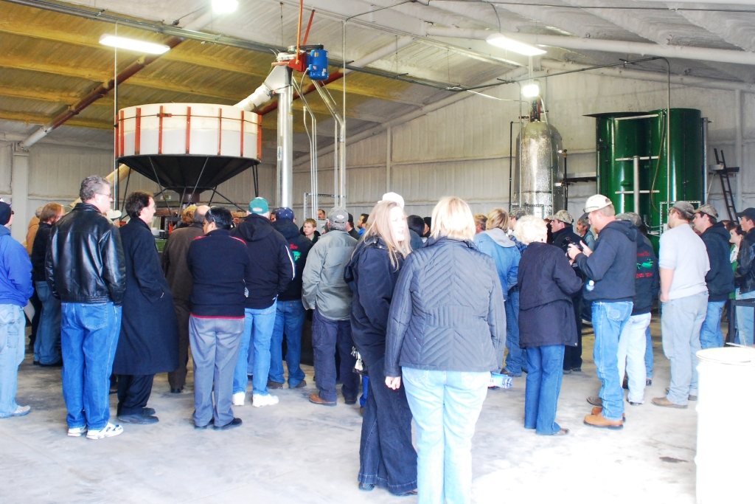
Thank you!

